Slide 1
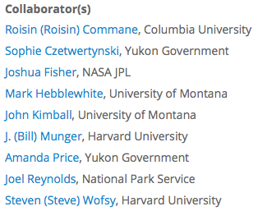
Quantifying socioecological consequences of changing snow & icescapes
Natalie Boelman¹, Todd Brinkman², Glen Liston³,
Laura Prugh⁴, and Adele Reinking³
¹Lamont-Doherty Earth Observatory, Columbia University, ²University of Alaska Fairbanks, ³Colorado State University, ⁴University of Washington

Slide 2
Motivation & Science Goal
Because ABR snow and icescapes are rapidly changing,
we will quantitatively evaluate recent and projected changes to:
Natural resources &
Subsistence opportunities
Winter transportation networks
C cycling & Climate regulation
Obj. 1: Quantify past and present-day spatiotemporal dynamics of snow- and ice-scapes throughout the ABoVE Study Domain.
Obj. 2: Quantify relationships between dynamics of snow- and ice-scapes (from Obj. 1) and variations in: (a) the efficacy of moose survey methods; (b) moose hunt success rates; and (c) moose-vehicle collisions on roadways.
Obj. 3: Quantify relationships between spatiotemporal dynamics of snow- and ice-scapes (from Obj. 1) and variation in the seasonality, duration, and safety of vehicular travel along all-season and winter (snow & ice) roads during the snow- and ice-on season.
Obj. 4: Provide ABoVE carbon-cycle modeling groups with past, present, and future distributions of cold-region and cold-season variables (from Obj. 1).
Obj. 1: Quantify past and present-day spatiotemporal dynamics of snow- and ice-scapes throughout the ABoVE Study Domain.
Obj. 2: Quantify relationships between dynamics of snow- and ice-scapes (from Obj. 1) and variations in: (a) the efficacy of moose survey methods; (b) moose hunt success rates; and (c) moose-vehicle collisions on roadways.
Obj. 3: Quantify relationships between spatiotemporal dynamics of snow- and ice-scapes (from Obj. 1) and variation in the seasonality, duration, and safety of vehicular travel along all-season and winter (snow & ice) roads during the snow- and ice-on season.
Obj. 4: Provide ABoVE carbon-cycle modeling groups with past, present, and future distributions of cold-region and cold-season variables (from Obj. 1).
Obj. 1: Quantify past and present-day spatiotemporal dynamics of snow- and ice-scapes throughout the ABoVE Study Domain.
Obj. 2: Quantify relationships between dynamics of snow- and ice-scapes (from Obj. 1) and variations in: (a) the efficacy of moose survey methods; (b) moose hunt success rates; and (c) moose-vehicle collisions on roadways.
Obj. 3: Quantify relationships between spatiotemporal dynamics of snow- and ice-scapes (from Obj. 1) and variation in the seasonality, duration, and safety of vehicular travel along all-season and winter (snow & ice) roads during the snow- and ice-on season.
Obj. 4: Provide ABoVE carbon-cycle modeling groups with past, present, and future distributions of cold-region and cold-season variables (from Obj. 1).
Obj. 1: Quantify past and present-day spatiotemporal dynamics of snow- and ice-scapes throughout the ABoVE Study Domain.
Obj. 2: Quantify relationships between dynamics of snow- and ice-scapes (from Obj. 1) and variations in: (a) the efficacy of moose survey methods; (b) moose hunt success rates; and (c) moose-vehicle collisions on roadways.
Obj. 3: Quantify relationships between spatiotemporal dynamics of snow- and ice-scapes (from Obj. 1) and variation in the seasonality, duration, and safety of vehicular travel along all-season and winter (snow & ice) roads during the snow- and ice-on season.
Obj. 4: Provide ABoVE carbon-cycle modeling groups with past, present, and future distributions of cold-region and cold-season variables (from Obj. 1).
Obj. 1: Quantify past and present-day spatiotemporal dynamics of snow- and ice-scapes throughout the ABoVE Study Domain.
Obj. 2: Quantify relationships between dynamics of snow- and ice-scapes (from Obj. 1) and variations in: (a) the efficacy of moose survey methods; (b) moose hunt success rates; and (c) moose-vehicle collisions on roadways.
Obj. 3: Quantify relationships between spatiotemporal dynamics of snow- and ice-scapes (from Obj. 1) and variation in the seasonality, duration, and safety of vehicular travel along all-season and winter (snow & ice) roads during the snow- and ice-on season.
Obj. 4: Provide ABoVE carbon-cycle modeling groups with past, present, and future distributions of cold-region and cold-season variables (from Obj. 1).

Slide 3
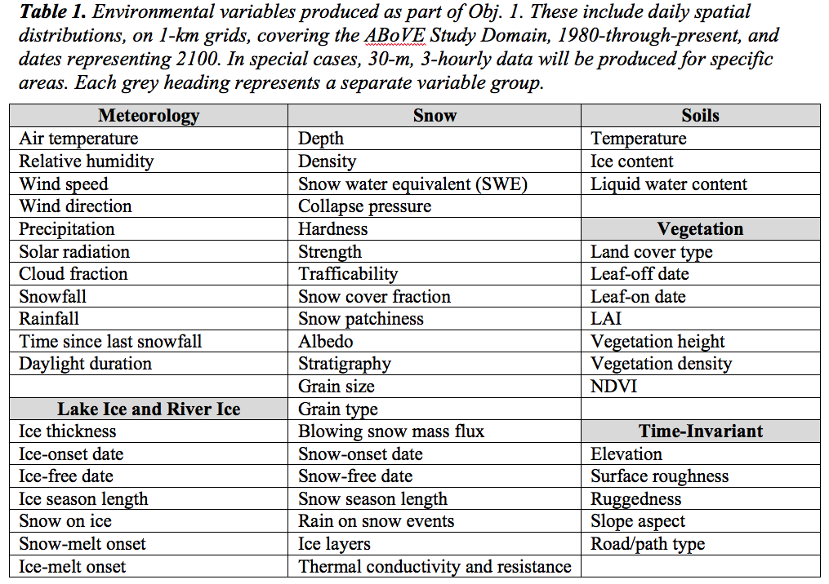
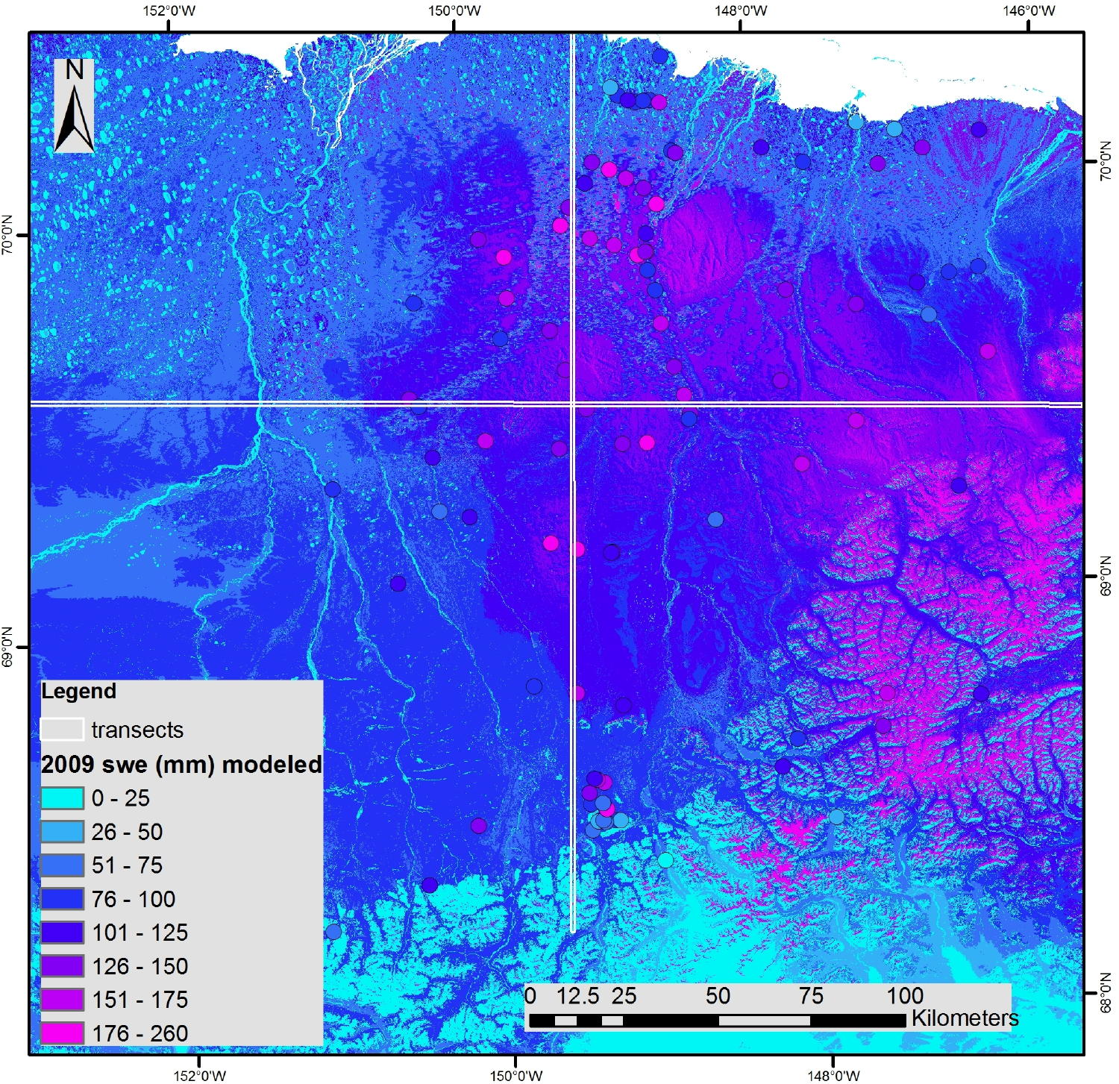
Objectives, Methods & Outcomes
Obj. 1: Quantify past and present-day spatiotemporal dynamics of snow- and ice-scapes throughout the ABoVE Study Domain.
In situ observations Remotely sensed Numerical models
observations
Data-Model Fusion
Cold-Season Environmental Variables
Temporal resolution: 3 hourly to daily
Temporal extent: 1980 - 2100
Spatial resolution: 30-m to 1-km grids
Spatial extent: ABoVE Study Domain
Notes:
Circles in both panels represent observations of snow water equivalent (SWE) made on 21 April 2009.

Slide 4
Societally-Relevant Environmental Variables (S-REVs) & Other Datasets
Objectives 2 – 4
Societally-Relevant Environmental Variables & Datasets
(S-REVs)
Societally-Relevant Environmental Variables & Datasets
(S-REVs)
Societally-Relevant Environmental Variables & Datasets
(S-REVs)

Slide 5
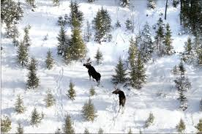
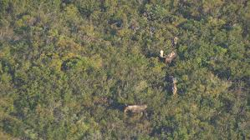
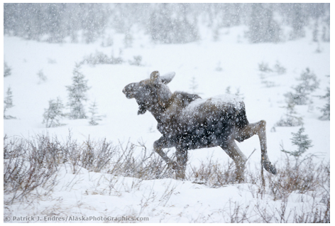
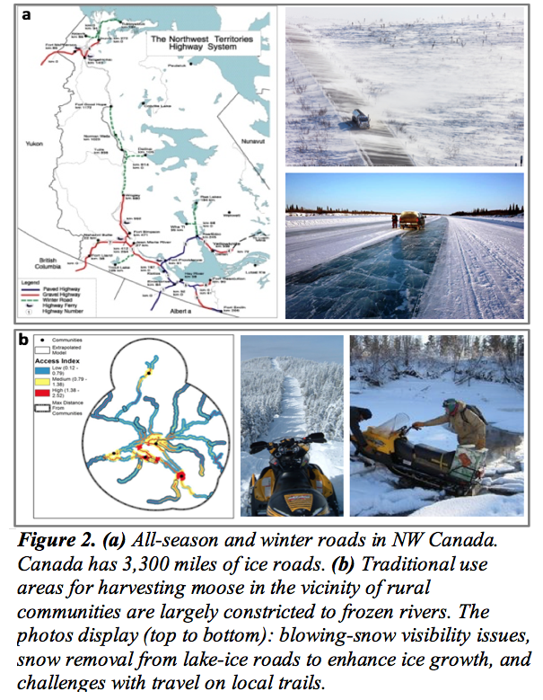
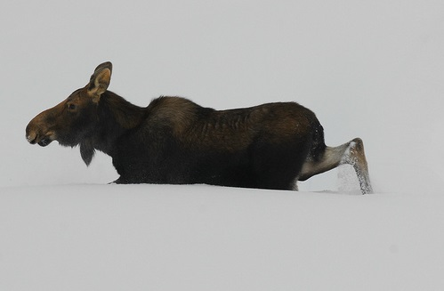
Obj. 2: Quantify relationships between dynamics of snow- and ice-scapes and variations in:
S-REV:
Moose Survey
Quality Index
Nov. snow cover
the efficacy of
moose survey methods
moose hunt
success rates
Fall snowfall
Moose Collision Risk Index
Winter transportation networks
S-REV:
Winter transportation networks
moose-vehicle
collisions on roadways
Winter snow depth
S-REVs
Road Trafficability Index (by weight class for ice roads)
Travel Conditions Index (related to factors such as snowdrifts on roads)
Blowing Snow Visibility Index (Tabler 1979, 1984, 1994, 2003)
Snowmachine-Travel Index (Liston and Reinking, unpublished manuscript)
Wind Chill Index (Osczevski and Bluestein 2005)
S-REVs
Road Trafficability Index (by weight class for ice roads)
Travel Conditions Index (related to factors such as snowdrifts on roads)
Blowing Snow Visibility Index (Tabler 1979, 1984, 1994, 2003)
Snowmachine-Travel Index (Liston and Reinking, unpublished manuscript)
Wind Chill Index (Osczevski and Bluestein 2005)
S-REVs
Road Trafficability Index (by weight class for ice roads)
Travel Conditions Index (related to factors such as snowdrifts on roads)
Blowing Snow Visibility Index (Tabler 1979, 1984, 1994, 2003)
Snowmachine-Travel Index (Liston and Reinking, unpublished manuscript)
Wind Chill Index (Osczevski and Bluestein 2005)
S-REVs
Road Trafficability Index (by weight class for ice roads)
Travel Conditions Index (related to factors such as snowdrifts on roads)
Blowing Snow Visibility Index (Tabler 1979, 1984, 1994, 2003)
Snowmachine-Travel Index (Liston and Reinking, unpublished manuscript)
Wind Chill Index (Osczevski and Bluestein 2005)
S-REVs
Road Trafficability Index (by weight class for ice roads)
Travel Conditions Index (related to factors such as snowdrifts on roads)
Blowing Snow Visibility Index (Tabler 1979, 1984, 1994, 2003)
Snowmachine-Travel Index (Liston and Reinking, unpublished manuscript)
Wind Chill Index (Osczevski and Bluestein 2005)
Ungulates avoid deep snow
(Dailey & Hobbs 1989, Mahoney et al. 2018)

Slide 6
Obj. 3: Quantify relationships between spatiotemporal dynamics of snow- and ice-scapes and variation in the seasonality, duration, and safety of travel along roads and trails during the snow- and ice-on season.
S-REVs:
Road Trafficability Index
(by weight class for ice roads)
Travel Conditions Index
(ie. snowdrifts on roads)
Blowing Snow Visibility Index
(Tabler 1979, 1984, 1994, 2003)
Snowmachine-Travel Index
(Liston and Reinking, unpublished manuscript)
Wind Chill Index
(Osczevski and Bluestein 2005)
Winter transportation networks
Winter transportation networks
S-REVs
Road Trafficability Index (by weight class for ice roads)
Travel Conditions Index (related to factors such as snowdrifts on roads)
Blowing Snow Visibility Index (Tabler 1979, 1984, 1994, 2003)
Snowmachine-Travel Index (Liston and Reinking, unpublished manuscript)
Wind Chill Index (Osczevski and Bluestein 2005)
S-REVs
Road Trafficability Index (by weight class for ice roads)
Travel Conditions Index (related to factors such as snowdrifts on roads)
Blowing Snow Visibility Index (Tabler 1979, 1984, 1994, 2003)
Snowmachine-Travel Index (Liston and Reinking, unpublished manuscript)
Wind Chill Index (Osczevski and Bluestein 2005)
S-REVs
Road Trafficability Index (by weight class for ice roads)
Travel Conditions Index (related to factors such as snowdrifts on roads)
Blowing Snow Visibility Index (Tabler 1979, 1984, 1994, 2003)
Snowmachine-Travel Index (Liston and Reinking, unpublished manuscript)
Wind Chill Index (Osczevski and Bluestein 2005)
S-REVs
Road Trafficability Index (by weight class for ice roads)
Travel Conditions Index (related to factors such as snowdrifts on roads)
Blowing Snow Visibility Index (Tabler 1979, 1984, 1994, 2003)
Snowmachine-Travel Index (Liston and Reinking, unpublished manuscript)
Wind Chill Index (Osczevski and Bluestein 2005)
S-REVs
Road Trafficability Index (by weight class for ice roads)
Travel Conditions Index (related to factors such as snowdrifts on roads)
Blowing Snow Visibility Index (Tabler 1979, 1984, 1994, 2003)
Snowmachine-Travel Index (Liston and Reinking, unpublished manuscript)
Wind Chill Index (Osczevski and Bluestein 2005)

Slide 7
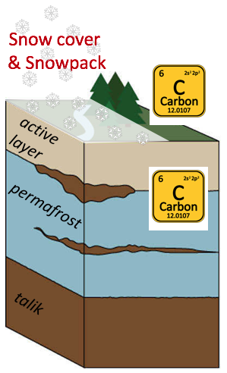
Obj. 4: Provide ABoVE carbon-cycle modeling groups with past, present, and future distributions of cold-region and cold-season variables.
snow-cover fraction
snow depth
snow density
ground surface temperature
soil temperature (10-cm increments down to 60 cm)
snow layer-specific thermal conductivity
snowpack thermal resistance

